Slide 1
William Shakespeare in Our Life
(based upon films and cartoons)
Vinogradova A., Molgachyova O. 2nd year, group 1

Slide 2
William Shakespeare plays a big role in everyone’s life. He has influenced many spheres, including the cultural one. We have been meeting him unconsciously since childhood.

Slide 3
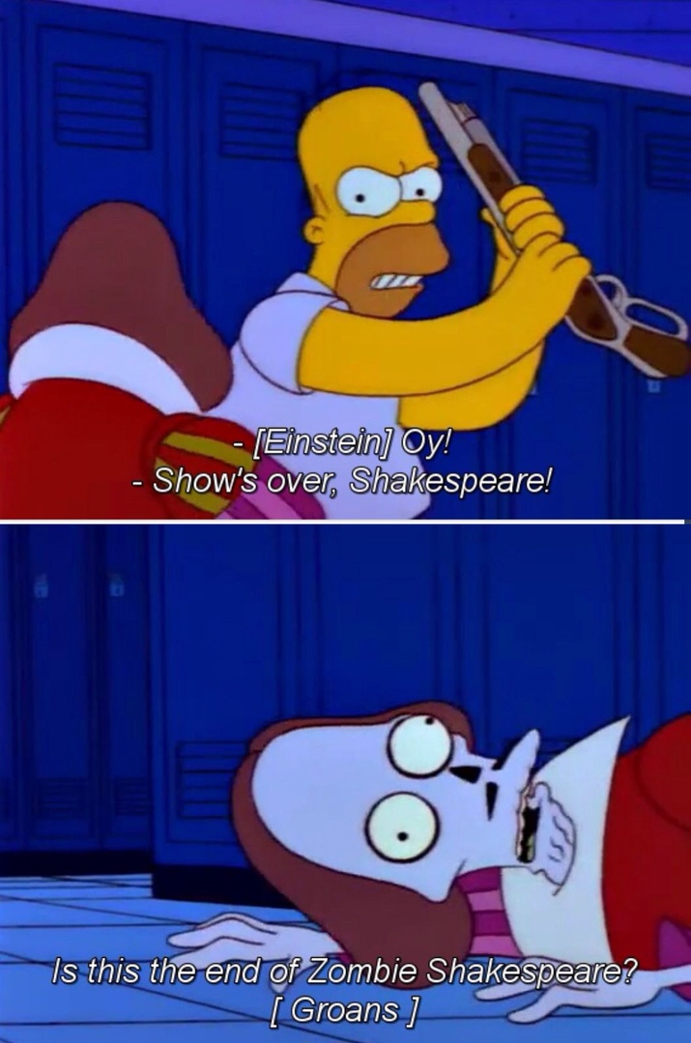
The Simpsons
"Treehouse of Horror III" is the fifth episode of the fourth season. In this episode such famous personalities as George Washington, Albert Einstein and William Shakespeare appear in the guise of zombies.

Slide 4

The Lion King
Having betrayed his brother and set up his murder, the treacherous uncle takes the throne. The young crown Prince is forced to flee and then fight with him for his right to the throne. It reminds the plot of “Hamlet”, doesn’t it? According to the creators, the play was taken

Slide 5
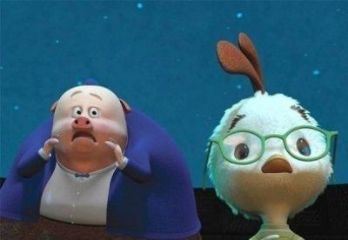
Chicken Little
Chicken Little is a 2005 American 3D computer-animated cartoon. One of the main characters, Runt of the Litter, quoted Shakespeare sonnet 90 in the Russian dubbing. In the original it was just the song “It’s too late” by Carole King.

Slide 6

Doctor Who
William Shakespeare himself makes a brief appearance on the Time-Space Visualizer in the episode "The Chase," and the Doctor mentions having met him in "City of Death," but Shakespeare doesn't actually meet the Doctor on screen until "The Shakespeare Code“.

Slide 7
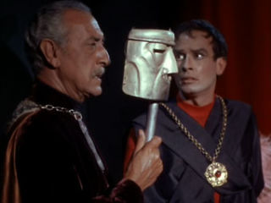
Star Trek
A Shakespearean actor comes on board the Enterprise — but is he secretly the former dictator who condemned many of his people, including members of Kirk's and Riley's families, to death? The only way to find out is with lots of Shakespearean speechifying, plus tons of snippets of MacBeth, Hamlet and Julius Caesar. This is possibly the greatest Shakespeare riff on ”Trek”.

Slide 8

10 Things I Hate About You
The screenplay is a modernization of late-16th-century comedy “The Taming of the Shrew”, retold in a late-1990s American high school setting. Not only the plot of the play was borrowed. The conflicts of "Romeo and Juliet" were added, too. Toponymic names from the works of the English playwright were changed into proper names (Verona, Stratford).

Slide 9
Thus, William Shakespeare accompanies each of us throughout the entire course of life, starting from childhood and ending in old age. We may not notice it, but the fact remains. And this is not surprising because the work of Shakespeare moves freely through time frames and remains relevant in any period of human development. In his works the author touches on absolutely all possible topics related to being.

Slide 10
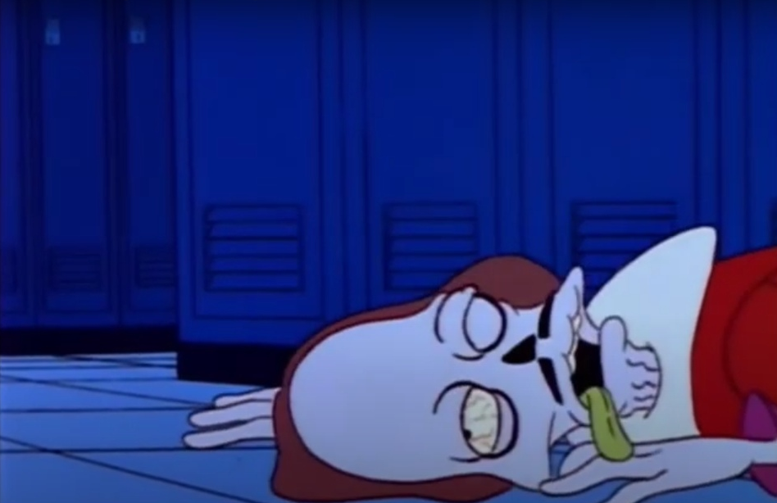
That’s all. Thank you for your attention.

